Slide 1
Website Project
Developing a dynamic web application

Slide 2
The Idea
What is it or what does it sell
The project has a plan making an website for a hotel with a booking feature, check room availability function.
Who is the website targeted to?
For someone need check room availability online
For someone need receive latest news and event from the hotel
For someone need make a reservation online
For admin manages customers.

Slide 3
The Plan
Wireframe
Home page
Login
Account profile
Rooms
Reservation

Slide 4
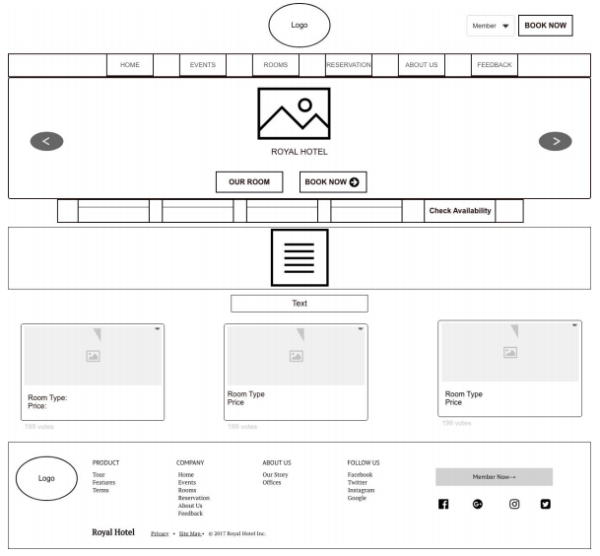
The plan
Wire frame
Home page

Slide 5
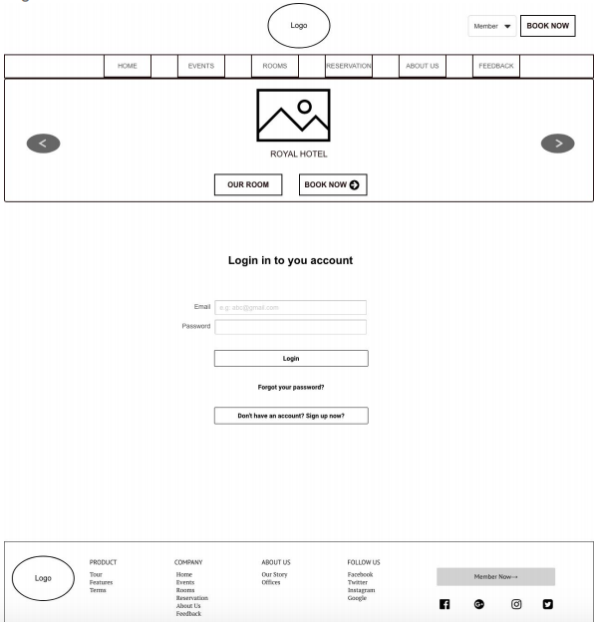
The plan
Wire frame
Login

Slide 6
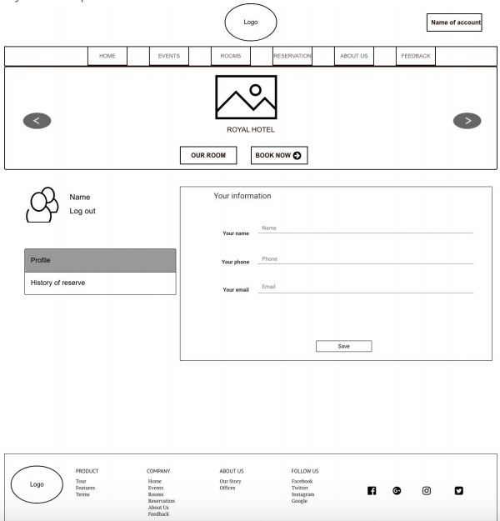
The plan
Wire frame
Account Profile

Slide 7
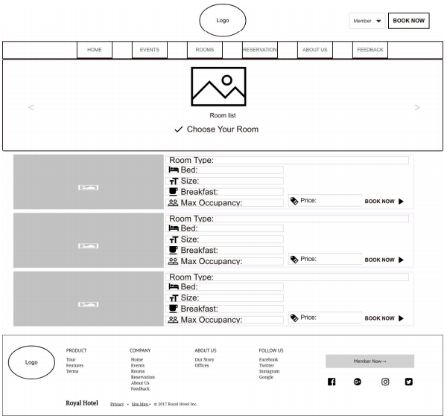
The plan
Wire frame
Rooms

Slide 8
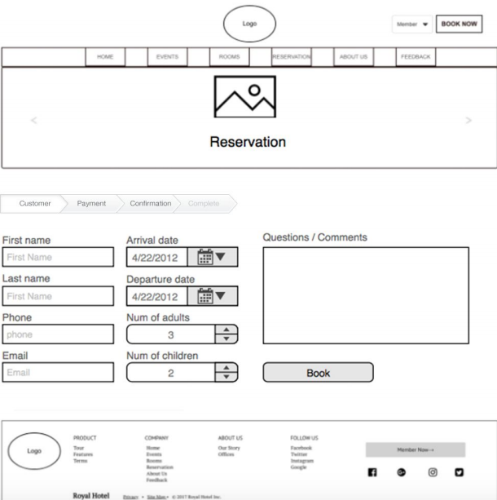
The plan
Wire frame
Reservation

Slide 9
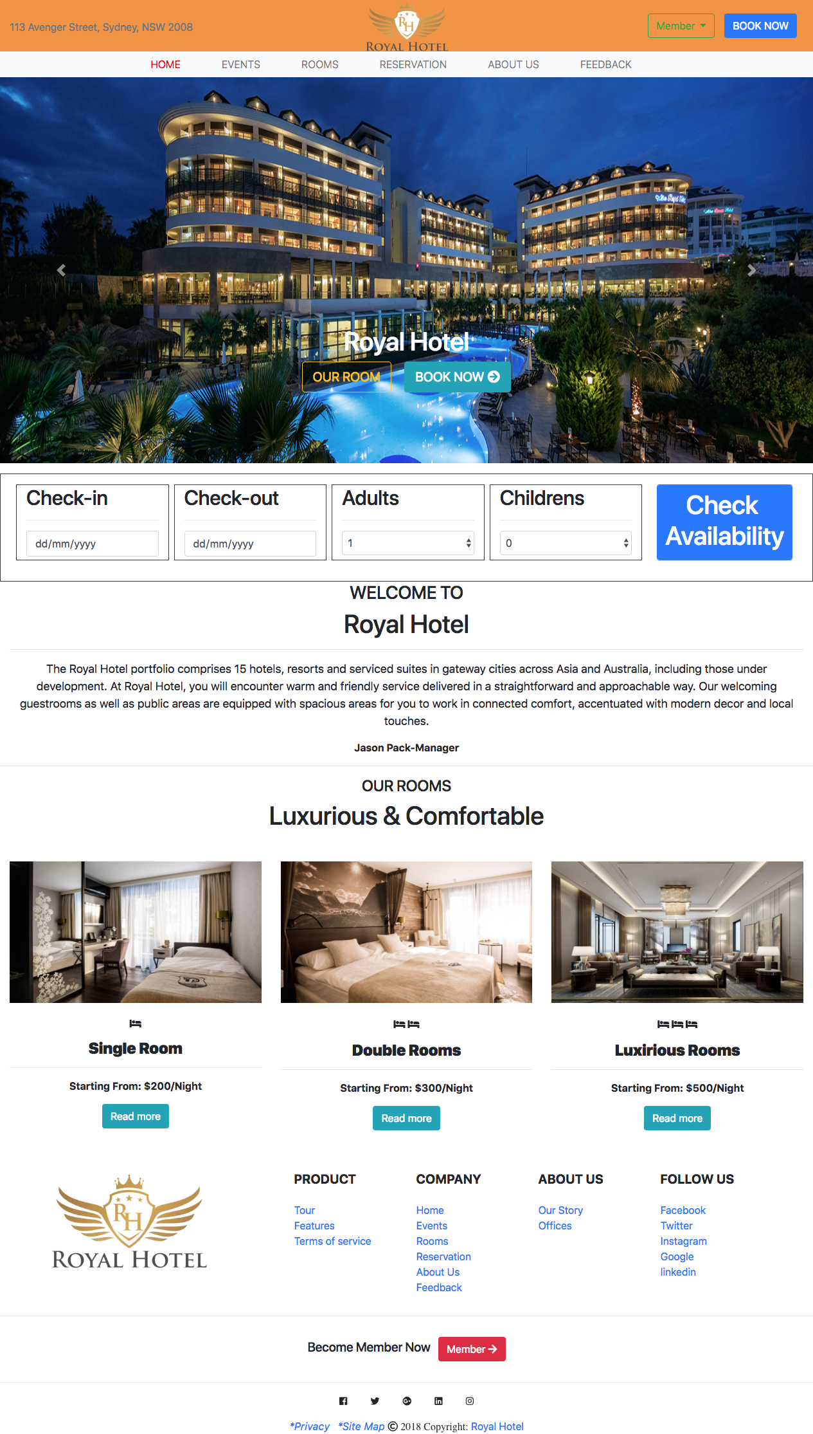
The Design
Mockup
Home page

Slide 10
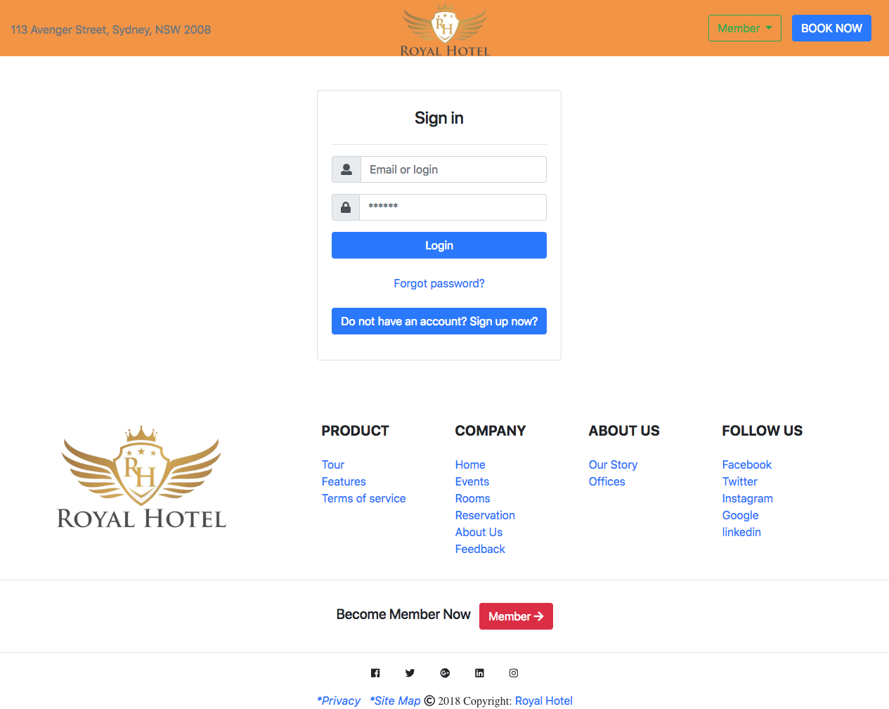
The Design
Mockup
Login

Slide 11
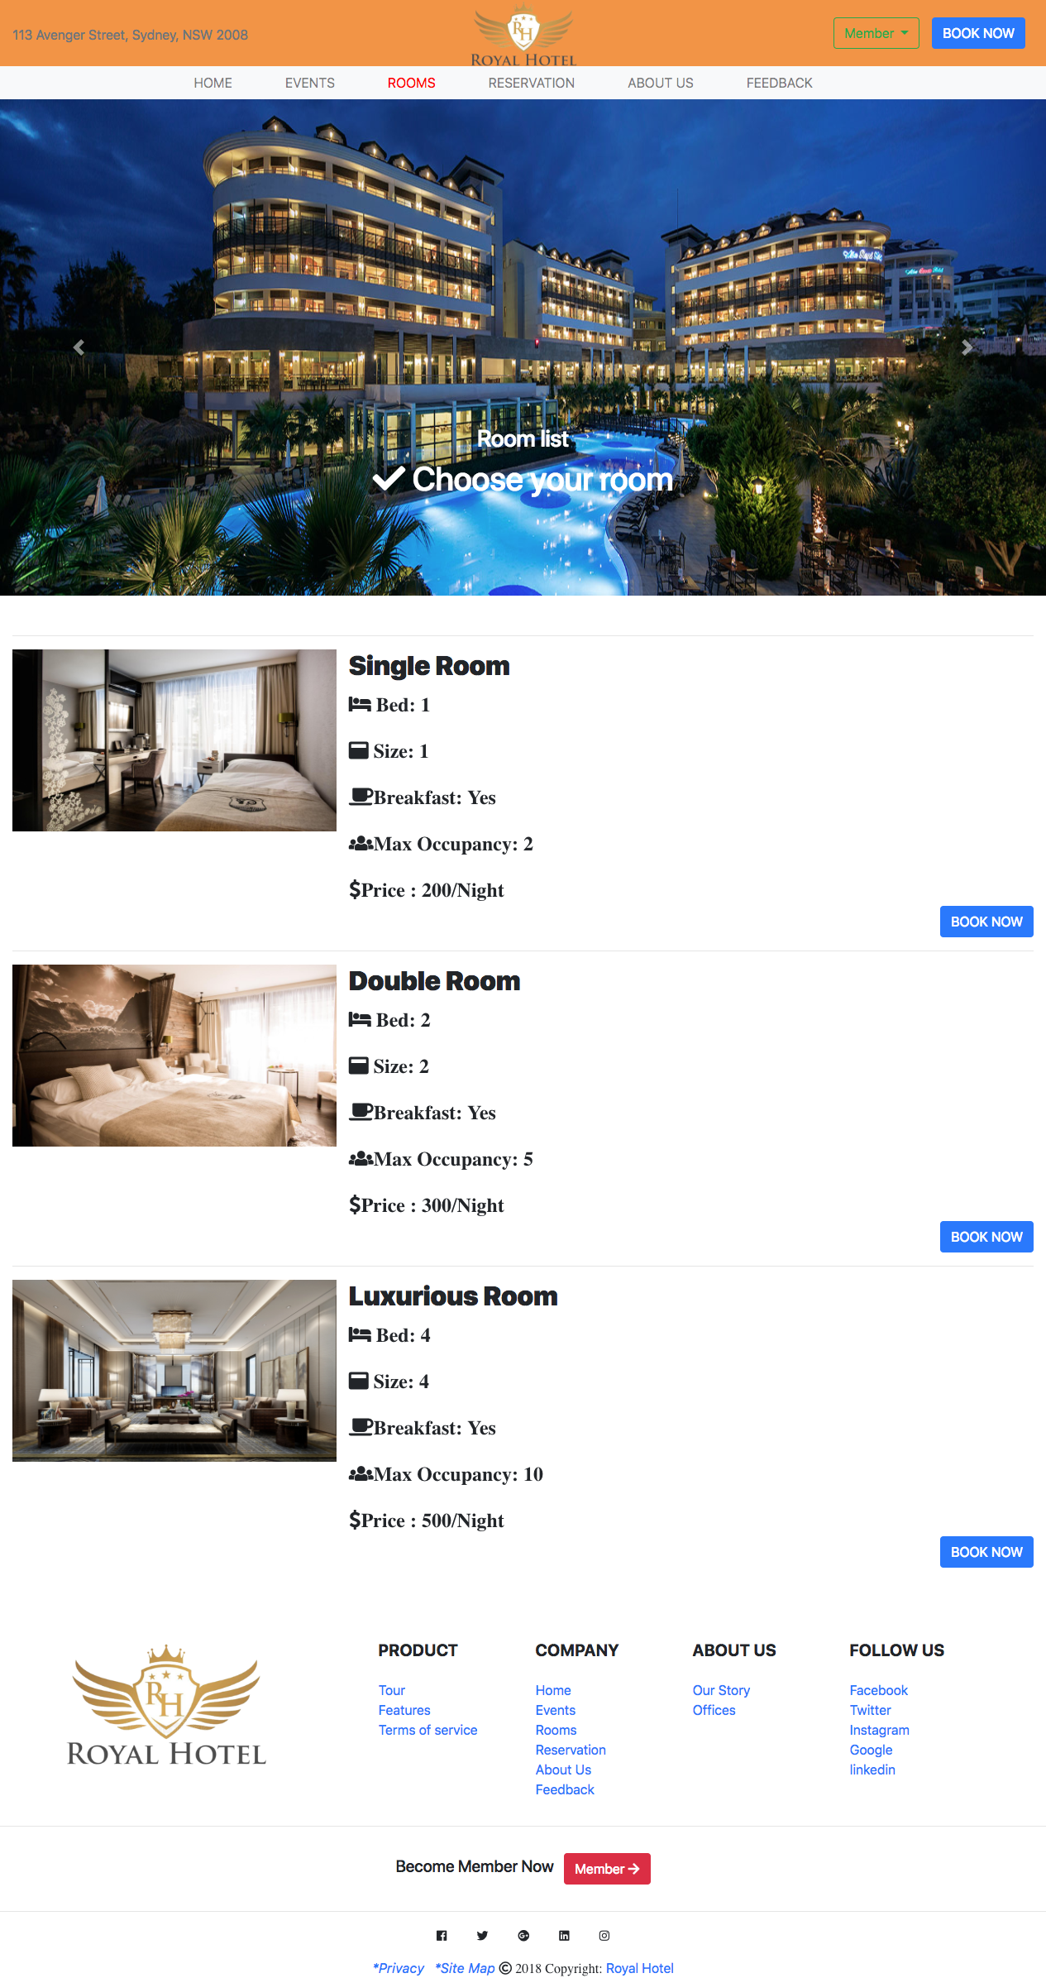
The Design
Mockup
Room

Slide 12
The Process
Talk about the process of building the project
Ben: work with login, home page, feedback and other page.
Andy: work with the reservation page and booking process.
How did you collaborate?
Tools: C9 chat and share workspace
SMS
Meeting in school

Slide 13
Build
The final project is almost similar with the design.

Slide 14
Take Aways
What would you do differently next time?
What were the main challenges about working in a team?
Find the way to share code and database
Did you find meeting with your counterpart difficult?
Yes, because there are some interruption during working relating to the partner working time.
Does the division between design and code work in a project?
No, we work together about the design and code.
Did you suffer any loss of assets (eg data or property loss)
Yes, it took time to compare code when we combined code together and made a lost coding when pushing to Github due to insufficient skills.
other valid points
Need add extra time for fixing code when integrate code together.

Slide 15
See You Later
We are not going to launch it at the moment due to the incomplete of design and function. Moreover, it need extra improvement before go to the market.

